Slide 1
SWE General Meeting
Monday, October 3, 2011
5:00pm-6:00pm
Bourns A265

Slide 2
Ice Breaker Time
Let’s get to know each other!
How to participate:
Try to pop the person’s balloon while still keeping your balloon intact
If your balloon pops, there will a piece of paper in your balloon. Hold on to it as you graciously exit from the game.

Slide 3
Ice Breaker (cont’d)
Remember the paper that magically appeared from your balloon?

Slide 4
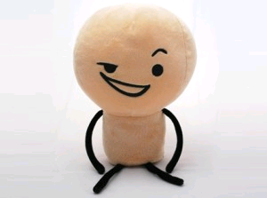
Ice Breaker (cont’d)
For each number, tell us something about yourself…

Slide 5
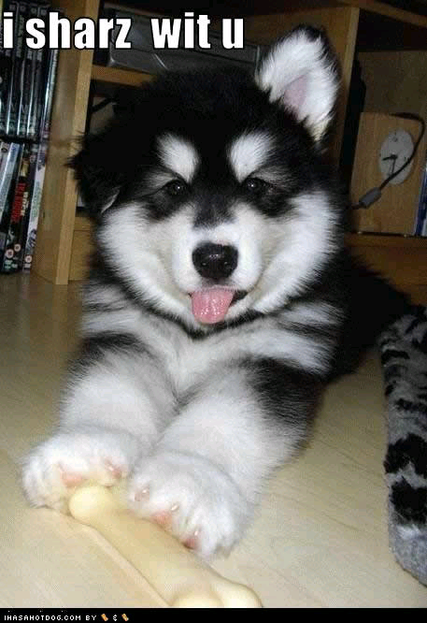
We want to hear from you!
Sharing is
Caring ☺

Slide 6
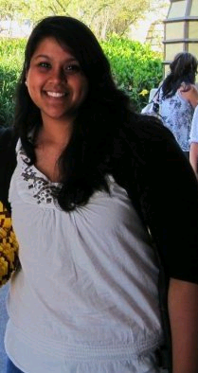
Meet the Officers
Vice President Nidhanjali Bansal (you can call her Nidhi)
Favorite color: Purple!
Favorite food: pizza and nachos
Favorite sport: soccer
Favorite bumper sticker: don't have any :/
Weirdest thing you've ever eaten: sorry i can't think of any right now haha
Traffic pet peeve: when people switch lanes without a signal
Pepsi or coke? boothh

Slide 7
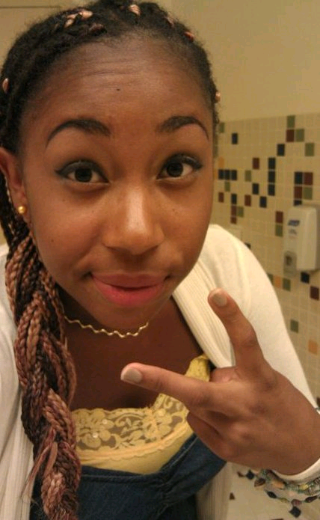
Meet the Officers
Secretary Daneshia Slaughter
Favorite color: Orange & black , Purple
Favorite food: spaghetti (homemade <3)
Favorite sport: Volleyball
Favorite bumper sticker: "Get hit or get laid"
Weirdest thing you've ever eaten: ice cream with hot sauce
Traffic pet peeve (story if you have one): people who are rude and don't signal!!!
Pepsi or coke?: Pepsi :]

Slide 8
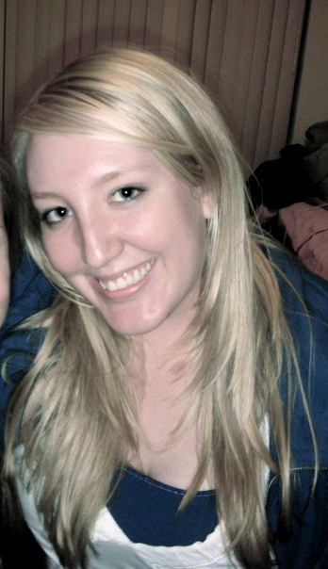
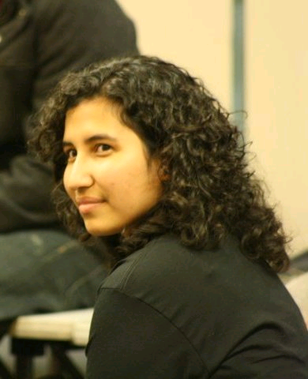
Meet the Officers
Treasurer Lauren Richards
Treasurer Rosalva (Salsa) Chavez

Slide 9
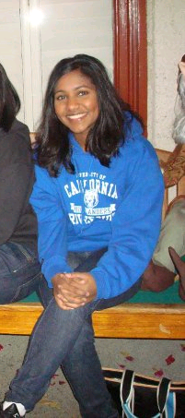
Meet the Officers
Professional Development Shanin Quazi
Favorite color: Teal
Favorite food: Sandwich
Favorite sport: Basketball
Favorite bumper sticker: Coexist (written with all the religious symbols combined)
Weirdest thing you've ever eaten: Grass
Traffic pet peeve (story if you have one): I get annoyed of all the camera lights.
Pepsi or coke? Pepsi

Slide 10
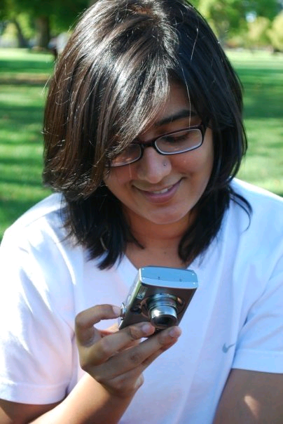
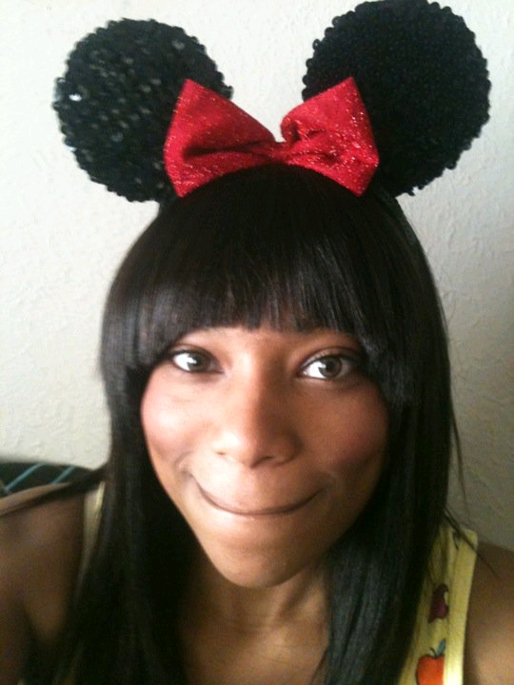
Meet the Officers
Outreach Karishma Jadeja
Outreach Breanne (Bree) Felton

Slide 11
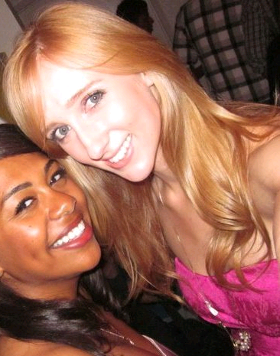
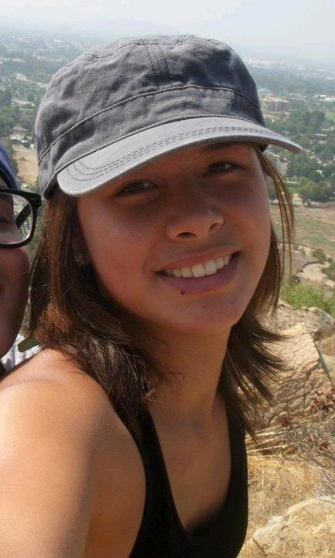
Meet the Officers
Social Coordinator Elizabeth (Liz) Horstman
Social Coordinator Rachael Lomax

Slide 12
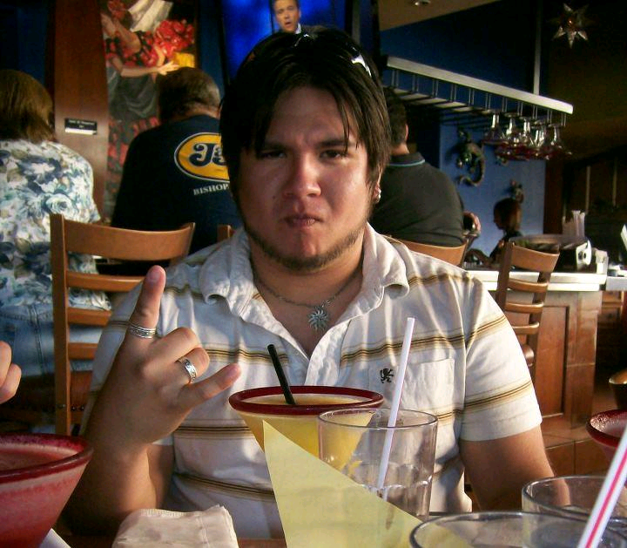
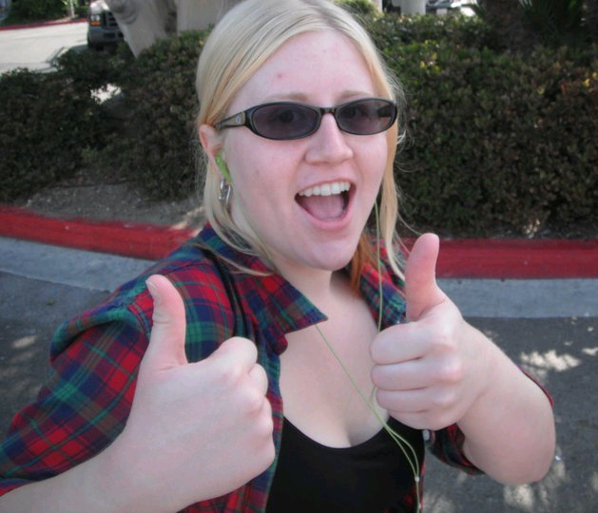
Meet the Officers
Historian Luis Balderrama
Webmaster Josephine Havers

Slide 13
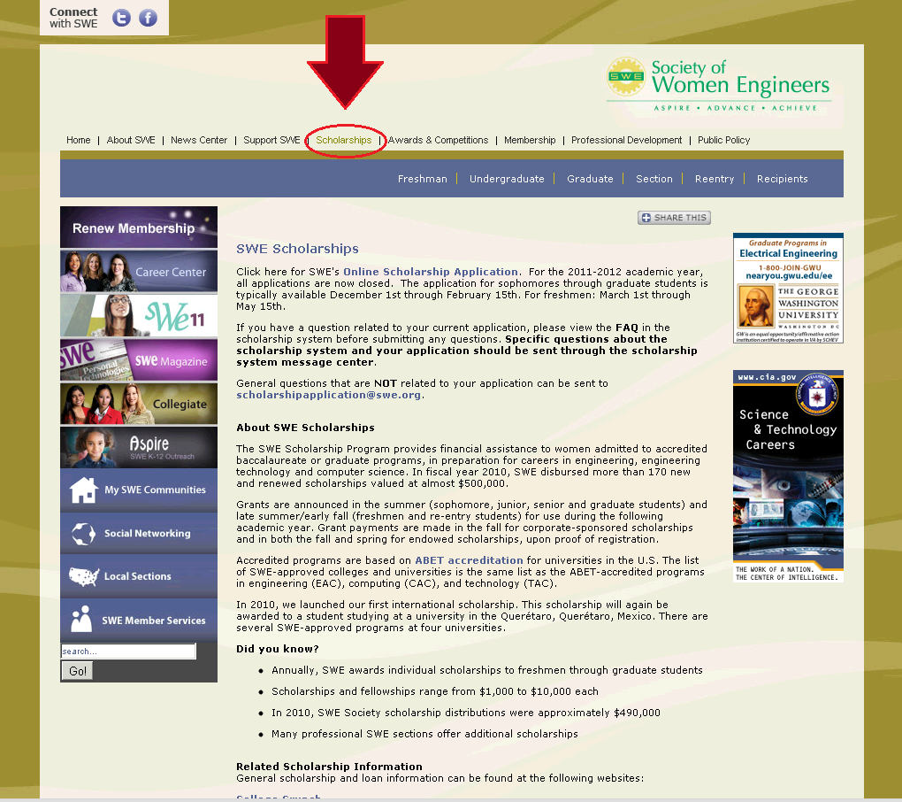
What SWE can offer YOU
Scholarships

Slide 14
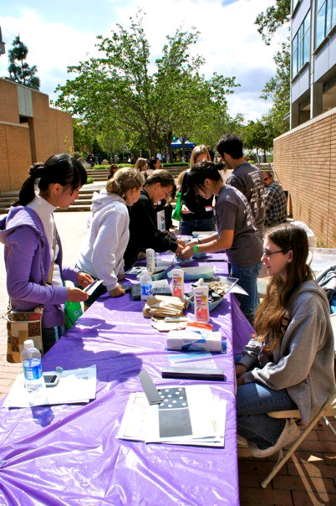
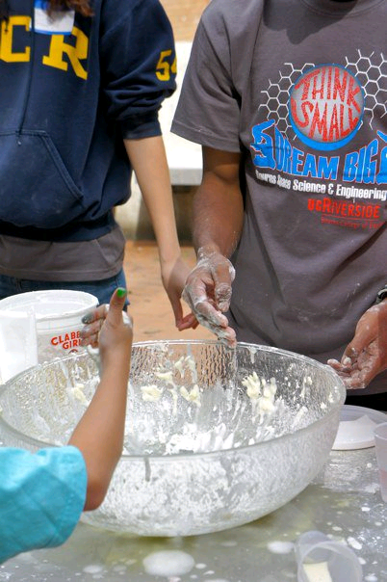
What SWE can offer YOU
Outreach/Volunteer Hours

Slide 15
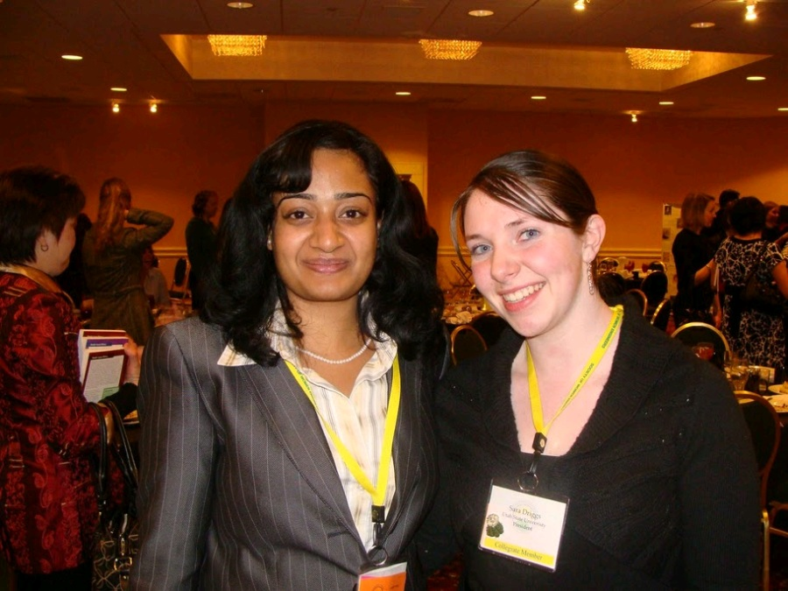
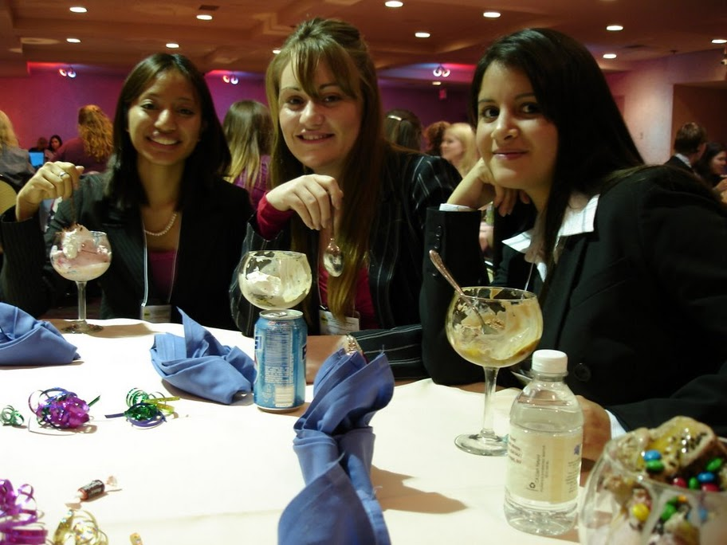
What SWE can offer YOU
Professional and Career Development

Slide 16
Were you paying attention?

Slide 17
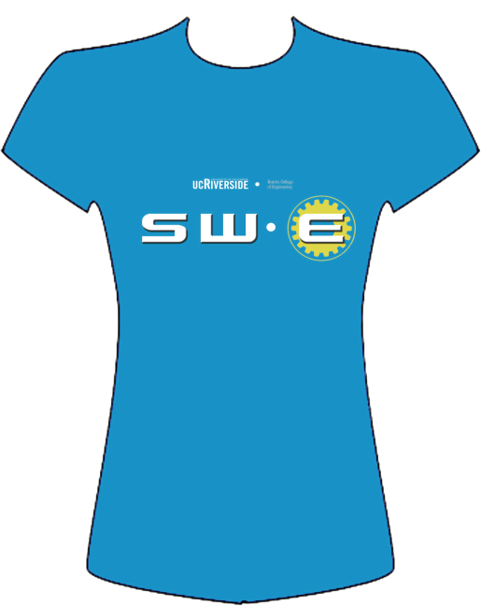

T-Shirt Design Contest
Email/facebook us your designs!
swe@engr.ucr.edu

Slide 18
See you next time!
Next Meeting:
Monday, October 17th, 2011 5-6pm, Bourns A265

